Slide 1
DRIVER’S BLIND EYE DETECTION (CNN)
SUMITHRA DEVI R
960521104064
Computer Science Engineering
AU960521104064
sumithradevi430@gmail.com
CAPE INSTITUTIONS OF TECHNOLOGY

Slide 2
PROBLEM STATEMENT
Despite advancements in automotive safety, accidents due to driver distraction persist. A key factor is the driver's inability to maintain continuous visual focus on the road. To prevent accidents, there's a critical need for a reliable Driver's Blind Eye Detection System. This system must accurately identify instances where the driver's eyes are diverted from the road due to drowsiness, distraction, or other factors, issuing timely warnings to avert potential accidents.

Slide 3
PROPOSED SYSTEM APPROACH
System Development Approach:
Requirements Analysis
Research and Prototyping
Hardware Development
Software Development
Testing and Validation
Integration and Deployment
Iterative Improvement

Slide 4
ALGORITHM AND DEPLOYMENT
Algorithm and Deployment:
1. Algorithm Development:
- Develop eye-tracking algorithms to analyze blink frequency, gaze direction, and pupil dilation.
- Implement real-time processing for timely detection of driver distraction or drowsiness.
- Integrate machine learning to differentiate intentional and unintentional eye movements.
2. Deployment:
- Integrate hardware and software components into a cohesive system architecture.
- Ensure compatibility and seamless integration with existing vehicle safety systems.
- Deploy the system in vehicles for testing and validation in real-world driving scenarios.

Slide 5
MODELLING
1. Data Collection and Preprocessing:
Collect Dataset: Gather a dataset of images or video frames showing drivers under various conditions, including drowsiness or inattention.
Labeling: Annotate the dataset to indicate instances where the driver's eyes are closed or not focused on the road.
Preprocessing: Resize images to a uniform size, normalize pixel values, and possibly augment the dataset to increase its diversity.
2. Model Architecture:
Convolutional Neural Network (CNN): Design a CNN architecture suitable for image processing. Include convolutional layers followed by pooling layers to capture spatial features effectively.
Attention Mechanism: Incorporate mechanisms to focus on eye regions, such as using attention layers or explicitly specifying regions of interest.
Output Layer: Design the output layer to provide binary classification - whether the driver's eyes are closed/blind or not.
.

Slide 6
MODELLING-Testing
3. Training:
Dataset Split: Divide the dataset into training and validation sets.
Loss Function: Define a suitable loss function, such as binary cross-entropy, to train the model for binary classification.
Optimizer: Choose an optimizer algorithm (e.g., Adam) to minimize the loss function during training.
Training Procedure: Train the model on the training set, adjusting model parameters through backpropagation.
Hyperparameter Tuning: Experiment with different hyperparameters (e.g., learning rate, batch size) to optimize performance on the validation set.
Regularization: Apply regularization techniques (e.g., dropout) to prevent overfitting.

Slide 7
MODELLING-Fine tuning,Performnance Analysis,
4. Fine-tuning and Optimization: Based on the evaluation results, fine-tune the model hyperparameters, architecture, or training process to improve performance. Techniques such as data augmentation, transfer learning, or architectural modifications may be employed.
5. Performance Analysis: Analyze the model's performance on different subsets of the test data, such as day/night conditions, various weather conditions, or different types of roads. Identify any limitations or areas for improvement based on the analysis.
6. Deployment Considerations: Consider practical deployment considerations such as computational efficiency, real-time performance, and integration with existing driver assistance systems or onboard hardware.

Slide 8
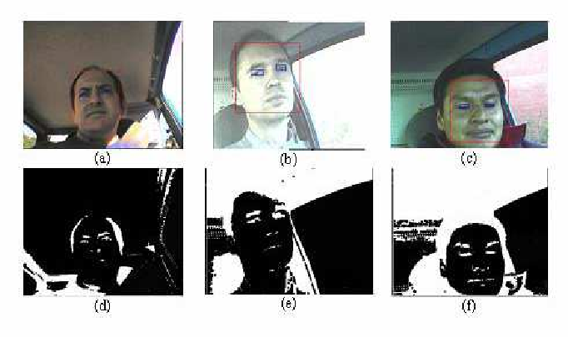
RESULTS

Slide 9
CONCLUTION
Conclusion:
The Driver's Blind Eye Detection System offers a vital solution to mitigate accidents caused by driver distraction. Through innovative hardware and software integration, it accurately tracks eye movements and issues timely alerts, enhancing road safety. Deployment in vehicles for real-world testing validates its effectiveness, marking a significant step towards safer driving experiences.

Slide 10
REFERENCES
Here are the links to install the mentioned Python libraries in the code:
1. [OpenCV](https://pypi.org/project/opencv-python/)
2. [PyTorch Official Website](https://pytorch.org/get-started/locally/)
3. [Imutils](https://pypi.org/project/imutils/)
4. [Pandas](https://pypi.org/project/pandas/)
5. [NumPy](https://pypi.org/project/numpy/)

Slide 11
Thank You !

